Slide 1
STM32 Dist
Micro302

Slide 2

Chrom-ART Accelerator™
Advanced data copy
For high quality graphic rendering image and bitmaps are preferred to simple shapes
Image building requires then a lot of image copies
A simple DMA is not efficient enough for image copies
➔ Simple DMA have to copy image portion by portion
many transfers and so many CPU interruptions
DMA2D is more adapted for graphic copies
It is able to manage the memory address jumps in the destination memory
Copy is done in one shot
Image to display
RAM
Flash
While the destination memory addresses in the image to be displayed are not contiguous
Images are stored in contiguous memory addresses

Slide 3


Chrom-ART Accelerator™
Advanced bit blending:
Chrom-ART accelerator handles the blending operations
Enabling image combining with different levels of transparency
Enhancing rendering quality
Offloading the CPU
Pixel format conversion:
Adapting used images to the display color format
Chrom-ART Accelerator effeciently offloads the CPU for repetitive
graphic operations

Slide 4



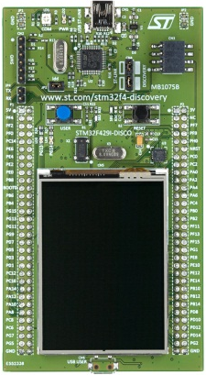
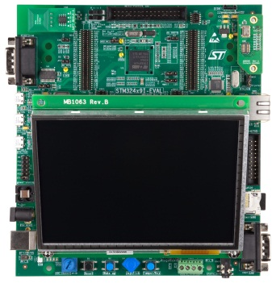
STM32F429 Graphic Enablers
Ecosystem
Partnership with lead graphic middleware providers to take full advantage of STM32F429 hardware capabilities in their solutions
Development boards and discovery kits
STM32F429I-DISCO
STM32439I-EVAL

Slide 5
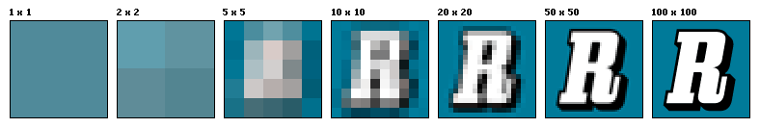
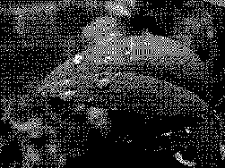
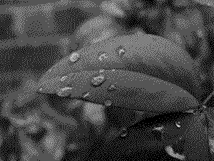



Image building overview
Displayed Images can have different resolution and color depth
Resolution is referring to horizontal and vertical pixels numbers
Resolution = number of horizontal pixels x number of vertical pixels
higher resolution ensures better rendering
Color depth is referring to how each pixel is represented in terms of color
the higher number of bits we use to represent a pixel, the better image quality we have
1 bit
2 bits
4 bits
8 bits
24 bits

Slide 6










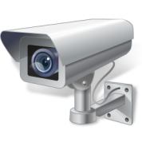




Image building overview
Final image is composed of different layers that are built one by one and stored in memory before being displayed on the panel
:
14
:
21
14
21
-5C
18 °C
ALARM
ALARM

Slide 7

Image building overview
Adding motion and graphical effects require to build 10 to 25 new image each second
14
:
21
18 °C
ALARM

Slide 8
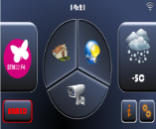

Displaying Overview
A controller is needed to fetch the build image from memory and feed the panel.
BUFFER
Refresh rate (60 Hz)
Panel
IMAGE BUILDING PROCESS
BUFFER
Panel
Controller
BUFFER
The Panel needs to be constantly refreshed to keep the image displayed
Usually a double buffer strategy is used to build and display images
While image is beeing built in one buffer, the controller displays the ready image from the second buffer.
Using a single buffer is possible
The same buffer is used for image building and displaying
Less memory requirements but synchronisation contraints
Some graphical libraries are able to handle single buffer graphic

Slide 9

Graphics enhancement enablers
Enhanced Graphics and display is a matter of system architecture
If system architecture challenges are not met, graphics and displaying will be affected
This will result in poor graphics quality and poor user experience
Processing performance challenge
System must be able to ensure high quality image building and main application processing needs at the same time.
If this challenge is not met:
Prioritizing main application will result in poor graphics with low quality rendering, jerky motions and jerky transitions.
Prioritizing graphics will prevent main applications from working properly.
For an audio player, audio glitches will then occur during image building processing.
➔ very bad impacts on the user experience.
VS
VS
VS

Slide 10
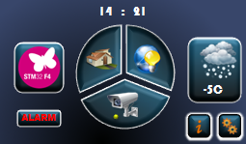

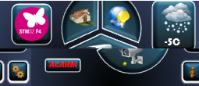
Graphics enhancement enablers
System architecture challenge
In addition to an efficient display controller, system architecture have to be tuned to support motion and display requirements (memory, transfer bandwidth, panel refresh and feeding constraints)
If the system architecture is not fine tuned for motion and displaying real time constraints won’t be met
Transfer bandwidth cannot support image creation copies and panel feeding
At refresh, underrun can occur and so if we don’t have large enough FIFO we can not overcome this underrun and image displayed will be corrupted.
Most of the time this corruptions are not recoverable and a reset is needed
Long underrun
short underrun= shift in image
During underrun corrupted data is displayed.
When usefull data arrive it will be displayed with a shifth

Slide 11

Graphic with STM32F429

Slide 12



STM32F429 and STM32F439
Ext
SDRAM
Image building
Displaying
Chrom-ARTTM
Image
layers
FMC
Display
60MHz
FIFO
CPU
TFT Controller
Image library
(shapes, bit maps, jpeg…)
225 DMIPS
IO
2MB Int
FLASH
Displaying requirements:
System Bandwidth
High resolution means more pixels and high pixel clock frequency.
Motion and effects mean display have to be fed with new image frequently (10-25 images /s) and so high bandwith constraints.
STM32 F4x9 differentiators
More than simple IPs, a fine tuned system architecture
FIFO added to TFT controller to handle real time constraints
Specific display IOs designed to reach 80MHz
Flexible Memory Controller (FMC) running at 90MHz
Image building requirements
System performance
Graphical processing performance
CPU load should not prevent other needed processing
Graphical capabilities
motion, blitting, pixel format conversion ...
Graphical middle ware ecosystem
Graphics creation quality and ease of use
World’s highest performance cortex-M MCU
Up to 225 DMIPS
Unique Chrom-ART acceleratorTM
Graphical acceleration perfuming blitting, pixel format conversions and image copies 2 times faster than the CPU itself
CPU offloading while offering higher graphical processing
More than MCU, a Full solution
Partnership with lead middleware providers to take full advantage of STM32F4 hardware capabilities in their solutions.

Slide 13

Image building Process:
14
:
21
14
:
21
-5C
-5C
ALARM
ALARM

Slide 14
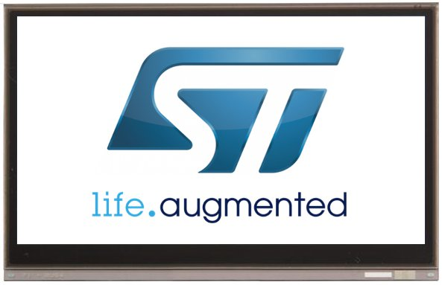

Image Building process
Display panel
Chrom-ART accelerator handles background creation.
It is able to build all simple shapes (rectangles, circles, …) without any CPU involvement
Internal RAM can store low resolution images (up to WQVGA)
CORTEX-M4
180MHz
FPU & DSP
LCD-TFT
controller
Chrom-ART
accelerator
For higher resolutions, external RAM is needed
STM32F4X9
FIFO
FIFO
D-Bus
I-Bus
SRAM
256KB
External
RAM
FMC
I-Code
2 MB Flash
D-Code
ART
Accelerator
Graphical library
Building
Background layer
Notes:
Fast Periph DMA bus to bypass the bus matrix
DMA bus for memory transfers: Flash, SRAMs, FMC go thru the Bus Matrix
DMA bus for peripheral transfers: AHB-APB bridges; Bus matrix slave ports
Bus Matrix allows the whole system: CPU+Memories and DMA transfers to work concurrently
Core-coupled Data RAM accessed only via D-Bus (By passing Bus Matrix)

Slide 15
Image Building process
Using STM32F429 internal RAM (256K) for small resolutions
bpp ↓ | resolution→
 | BUFFER SIZES (Kbytes) ↘ | CGA (320x200) | QVGA (320x240) | WQVGA (480x272) | VGA (640x480) | WVGA (800x480) | SVGA (800x600) | XGA (1024x768)
 | 1 (2 colors) | 7.8 | 9.4 | 15.9 | 37.5 | 46.9 | 58.6 | 96.0
 | 2 (4 colors) | 15.6 | 18.8 | 31.9 | 75.0 | 93.8 | 117.2 | 192.0
 | 4(16 colors) | 31.3 | 37.5 | 63.8 | 150.0 | 187.5 | 234.4 | 384.0
 | 8 (256 colors) | 62.5 | 75.0 | 127.5 | 300.0 | 375.0 | 468.8 | 768.0
 | 16 (high color) | 125.0 | 150.0 | 255.0 | 600.0 | 750.0 | 937.5 | 1536.0
 | 24 (true color) | 187.5 | 225.0 | 382.5 | 900.0 | 1125.0 | 1406.3 | 2304.0
 | 32 (deep color) | 250.0 | 300.0 | 510.0 | 1200.0 | 1500.0 | 1875.0 | 3072.0
Double buffer: New image and Frame buffers can be in internal RAM
Single buffer : 2 options:
Image can be handled by regions: one region to be displayed while the other is been built and so only one buffer will be needed
new image buffer in internal RAM and frame buffer in external RAM or in display internal memory.
External memory needed for both frame buffer and new image buffer

Slide 16
Image building Process:
14
:
21
-5C
ALARM

Slide 17
Image Building process
Display panel
Simple shapes are not suitable for enhanced graphics
Using bitmaps images is preferred
Bitmaps are stored in RAM and have not to be decoded
Graphical accelerator will handle pixel format conversion (to be compliant with the selected bpp), blending and copy.
CORTEX-M4
180MHz
FPU & DSP
LCD-TFT
controller
Chrom-ART
accelerator
STM32F4X9
FIFO
FIFO
D-Bus
I-Bus
SRAM
256KB
External
RAM
FMC
I-Code
2 MB Flash
D-Code
ART
Accelerator
Graphical library
Adding shapes
Notes:
Fast Periph DMA bus to bypass the bus matrix
DMA bus for memory transfers: Flash, SRAMs, FMC go thru the Bus Matrix
DMA bus for peripheral transfers: AHB-APB bridges; Bus matrix slave ports
Bus Matrix allows the whole system: CPU+Memories and DMA transfers to work concurrently
Core-coupled Data RAM accessed only via D-Bus (By passing Bus Matrix)

Slide 18
Image building Process:
14
:
21
-5C
ALARM

Slide 19





Image Building process
Display panel
Images can be coded (jpeg, ..) or not (bitmap).
CPU will only handle decoding and Chrom-ART will handle formating, blending and copy
decode
For bitmaps, decoding is not needed and so CPU is not involved
CORTEX-M4
180MHz
FPU & DSP
LCD-TFT
controller
Chrom-ART
accelerator
STM32F4X9
FIFO
FIFO
D-Bus
I-Bus
SRAM
256KB
External
RAM
FMC
I-Code
2 MB Flash
D-Code
ART
Accelerator
Graphical library
Adding images
Notes:
Fast Periph DMA bus to bypass the bus matrix
DMA bus for memory transfers: Flash, SRAMs, FMC go thru the Bus Matrix
DMA bus for peripheral transfers: AHB-APB bridges; Bus matrix slave ports
Bus Matrix allows the whole system: CPU+Memories and DMA transfers to work concurrently
Core-coupled Data RAM accessed only via D-Bus (By passing Bus Matrix)

Slide 20
Image building Process:
14
:
21
-5C
ALARM

Slide 21

Image Building process
Display panel
Graphical library associates a bitmap to each letter/number definition (ascii code, size and font).
Chrom-ART will handle pixel formating, blending and copy
CORTEX-M4
180MHz
FPU & DSP
LCD-TFT
controller
Chrom-ART
accelerator
STM32F4X9
FIFO
FIFO
D-Bus
I-Bus
14
21
:
SRAM
256KB
External
RAM
FMC
-5C
I-Code
2 MB Flash
ALARM
D-Code
ART
Accelerator
Graphical library
Adding texts
Notes:
Fast Periph DMA bus to bypass the bus matrix
DMA bus for memory transfers: Flash, SRAMs, FMC go thru the Bus Matrix
DMA bus for peripheral transfers: AHB-APB bridges; Bus matrix slave ports
Bus Matrix allows the whole system: CPU+Memories and DMA transfers to work concurrently
Core-coupled Data RAM accessed only via D-Bus (By passing Bus Matrix)

Slide 22
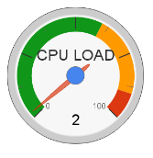
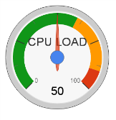
Image Building process: adding motion
Display panel
Motion enhances the graphical user interface and allows better user experience
Motion means building all or parts of the image from 10 to 25 new times each second
CORTEX-M4
180MHz
FPU & DSP
LCD-TFT
controller
Chrom-ART
accelerator
STM32F4X9
FIFO
FIFO
D-Bus
I-Bus
14
21
:
SRAM
256KB
External
RAM
FMC
-5C
I-Code
2 MB Flash
ALARM
D-Code
ART
Accelerator
Graphical library
Notes:
Fast Periph DMA bus to bypass the bus matrix
DMA bus for memory transfers: Flash, SRAMs, FMC go thru the Bus Matrix
DMA bus for peripheral transfers: AHB-APB bridges; Bus matrix slave ports
Bus Matrix allows the whole system: CPU+Memories and DMA transfers to work concurrently
Core-coupled Data RAM accessed only via D-Bus (By passing Bus Matrix)

Slide 23
Image Building process: Chrom-ART benefits
Display panel
In addition to graphics and display, CPU must handle tasks related to the main application.
CPU limitation prevents high quality applications with an enhanced graphical user interface.
Chrom-ART offloads the CPU
It is able to perform copies, pixel format conversion and blending 2 times faster than the CPU itself
Coupled with high performance cortex-M4 and ART-accelerator it is enabling quality applications with enhanced GUIs
CORTEX-M4
LCD-TFT
controller
Chrom-ART
accelerator
typical
180MHz
FPU & DSP
STM32F4X9
FIFO
FIFO
14
21
D-Bus
I-Bus
:
SRAM
256KB
External
RAM
FMC
-5C
ALARM
I-Code
Flash
2 MB Flash
D-Code
ART
Accelerator
Notes:
Fast Periph DMA bus to bypass the bus matrix
DMA bus for memory transfers: Flash, SRAMs, FMC go thru the Bus Matrix
DMA bus for peripheral transfers: AHB-APB bridges; Bus matrix slave ports
Bus Matrix allows the whole system: CPU+Memories and DMA transfers to work concurrently
Core-coupled Data RAM accessed only via D-Bus (By passing Bus Matrix)

Slide 24
Image Displaying process:
14
21
:
Most of the time a double buffer strategy is used:
While a buffer is beeing built, the second is displyed
-5C
Image displayed on the panel is constantly refreshed. Usual refresh rate is 60 Hz.
This means that the image is displayed 60 times each second
ALARM
clock
Display panels impose high frequency clocks. Needed clock frequency depends on panel resolution:
XVGA needs typical 65 MHz
CORTEX-M4
LCD-TFT
controller
Chrom-ART
accelerator
180MHz
FPU & DSP
STM32F4X9
FIFO
FIFO
14
21
D-Bus
I-Bus
:
SRAM
256KB
External
RAM
FMC
-5C
ALARM
I-Code
2 MB Flash
D-Code
ART
Accelerator
Notes:
Fast Periph DMA bus to bypass the bus matrix
DMA bus for memory transfers: Flash, SRAMs, FMC go thru the Bus Matrix
DMA bus for peripheral transfers: AHB-APB bridges; Bus matrix slave ports
Bus Matrix allows the whole system: CPU+Memories and DMA transfers to work concurrently
Core-coupled Data RAM accessed only via D-Bus (By passing Bus Matrix)

Slide 25
System architecture challenges
14
21
Graphical acceleration offloads the CPU enabling quality GUI AND high performance applications
:
For enhanced GUIs, Memory bandwidth is key. For low-mid resolutions SRAM can be used and so internal buses must support high bandwidth. For High resolution, a high performance external memory interface is a must
-5C
ALARM
clock
Display controller needs large enough FIFO to overcome potential real time issue (data is not ready for displaying on time)
CORTEX-M4
LCD-TFT
controller
Chrom-ART
accelerator
STM32F4X9
High speed IOs are needed to support high frequency clocks imposed by the display panel
180MHz
FPU & DSP
FIFO
FIFO
14
21
D-Bus
I-Bus
:
SRAM
256KB
External
RAM
FMC
-5C
ALARM
I-Code
2 MB Flash
D-Code
ART
Accelerator
Graphical library
Application
Notes:
Fast Periph DMA bus to bypass the bus matrix
DMA bus for memory transfers: Flash, SRAMs, FMC go thru the Bus Matrix
DMA bus for peripheral transfers: AHB-APB bridges; Bus matrix slave ports
Bus Matrix allows the whole system: CPU+Memories and DMA transfers to work concurrently
Core-coupled Data RAM accessed only via D-Bus (By passing Bus Matrix)

Slide 26
STemWin

Slide 27
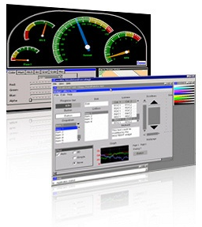
STemWin About STemWin
Professional graphical library based on Segger emWin
Scalable solution that can fit all STM32 MCUs
Works with any LCD controller
Embeds optimized drivers for various market LCD controllers in addition to the embedded STM32F4x9 TFT-LCD controller with DMA2D ChromART accelerator
Library provided in object code locked to STM32 MCUs
A set of PC software tools offered (GUI builder, simulator, bitmap converter,…)
Extensive set of examples provided on Segger website

Slide 28
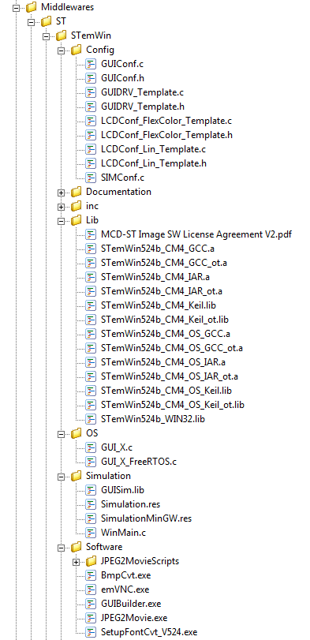
STemWin Library Structure
Template drivers configuration file
STemWin Libraries :
OS Support
CM core
Tool
OS related file (Timebase and debug macros)
Simulation library and interface files
STemWin misc. software

Slide 29


STemWin Basic features
Text display with multi-language and multiple fonts support
Bitmap drawing (line, circle, ..) with alpha blending support
Antialiasing feature for line, curves and fonts smoothing
Image file support for BMP, PNG, GIF and JPEG
Color management with fixed or custom palette options

Slide 30
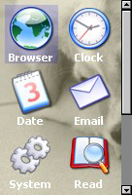
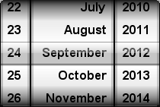
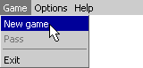
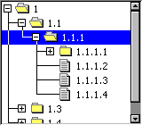
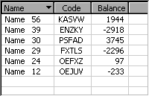
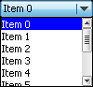
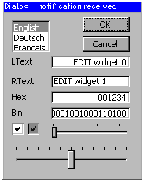
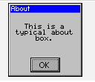
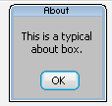
STemWin Window Features
Window management
Window objects (Widgets) library ex:
Progress bar
Check box
Button
List…
Dialogs windows (windows with combination of Widgets) for interaction with user
Objects skinning

Slide 31
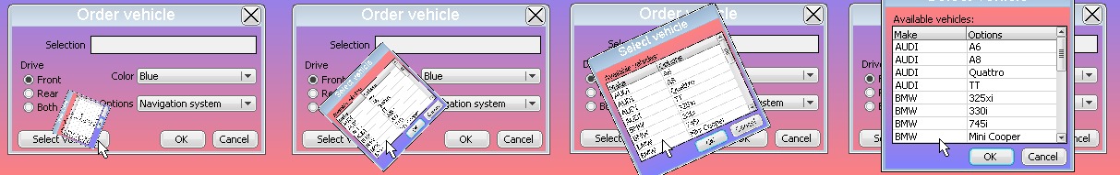
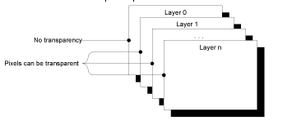
STemWin Acceleration Features
Memory device feature
Allows doing some graphical operation in memory (like scaling, rotation, animation,..) before display in LCD screen
Avoids flickering effects
Multi-buffer support
One front frame buffer used by display controller and one or more back frame buffers used for drawing operations, then back buffer becomes the front and so on
Avoids flickering and tearing effects
Multi-layer LCD controller support
Separate access to each display layer
Each layer has its own display driver

Slide 32

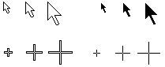
STemWin Other features
Animated sprites and cursors
Pointer Input device support (generic driver for touchscreen, mouse,..)
RTOS support
VNC server support

Slide 33
STemWin Architecture
Application program
STemWin
Widget Layer
Widget Library
Window Layer
Window Manager
Rendering Layer
Provided as object code library
GUI core
Output Layer
Memory Devices
VNC Server
Display Drivers
Need to be written by user to link a particular LCD driver and do BSP level initialization and configuration
Need to be adapted by user for STemWin modules and features selection and configuration
LCD configuration
GUI
configuration
STM32Cube HAL

Slide 34
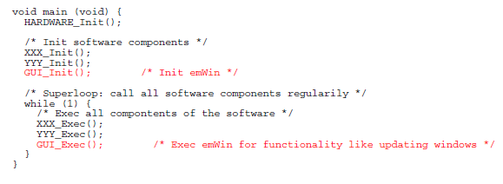
STemWin Execution model (1/2)
We have to basically distinguish between 2 different execution models:
Single task system (superloop) : The entire program runs in one superloop
➔ no real time kernel is used.

Slide 35
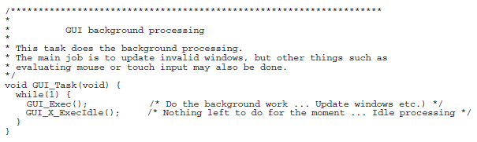
STemWin Execution model (2/2)
Multitask system: multiple tasks calling emWin. A real time kernel (RTOS) is used, and multiple tasks call emWin functions.
➔ multitask support in the configuration file should be enabled (for STemWin fixed in the binaries dedicated for OS)

Slide 36
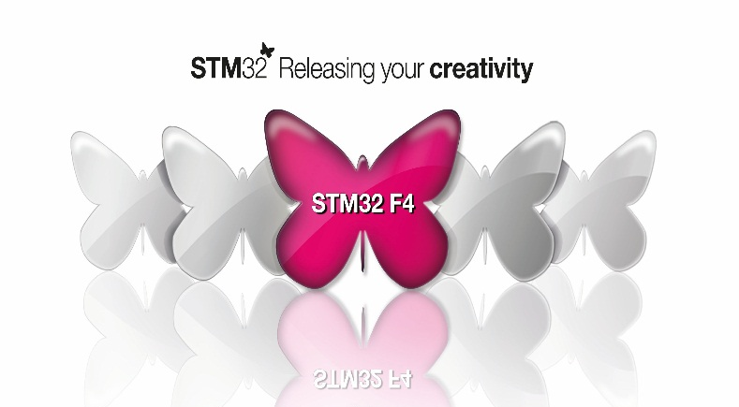
LCD-TFT Display Controller (LTDC)
MCD Application Team

Slide 37
LCD-TFT architecture
AHB Master Interface
Layer1
AHB Interface
FIFO
64x32b
PFC
LCD Panel
LCD_CLK
Blending
LCD_HSYNC
Layer2
FIFO
64x32b
PFC
LCD_VSYNC
Dithering
LCD_DE
LCD_R[7:0]
APB Interface
Configuration and status registers
LCD_G[7:0]
Synchronous Timings Generation
LCD_B[7:0]
Notes:
(PFC) = pixel format converter

Slide 38
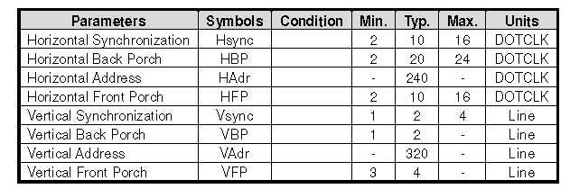
LTDC Timings
Start of Frame
HSYNC
HBP
Active Width
HFP
VSYNC
VBP
D1,L1
VBP: Vertical Back porch
VFP: Vertical Front porch
HBP: Horizontal Back porch
HFP: Horizontal Front porch
Active Heigh
These timings come from the datasheet of the display. E.g. TFT on discovery kit.
Dm,, Ln
VFP

Slide 39
Create project and add the STemWin

Slide 40
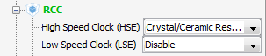
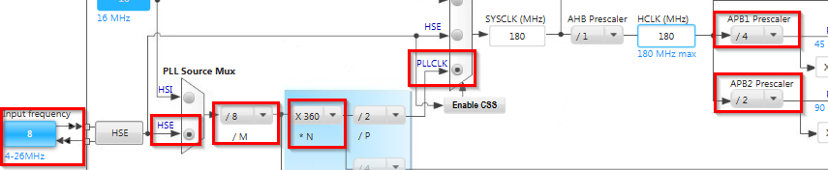
Create project
Create project in CubeMX
Menu > File > New Project
Select STM32F4 > STM32F429/439 > LQFP144 > STM32F439ZITx
We need only blank project with clock initialization
We only set the RCC and configure the core to maximum speed

Slide 41
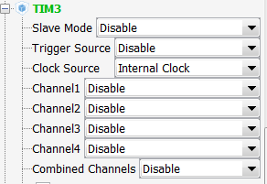
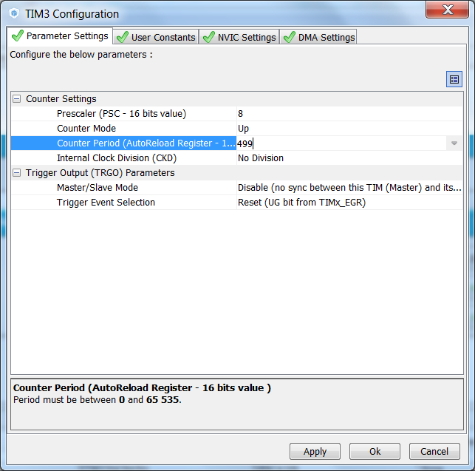
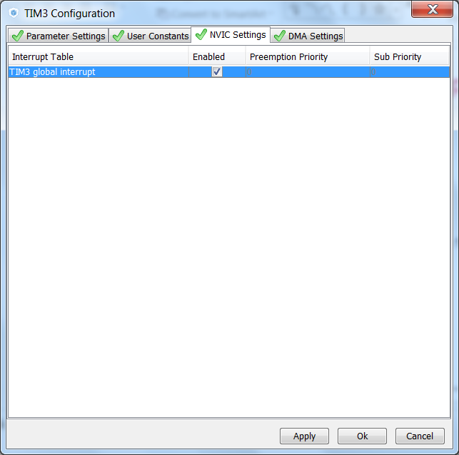
Setup project
Configure the TIM3 to have the internal clock source
Enable it’s interrupt service and configure it to have a 10KHz update

Slide 42
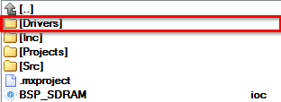
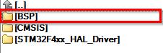
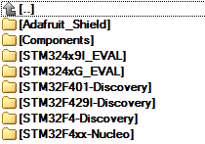
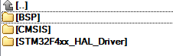
Use BSP for SDRAM initialization
The copy part
In our project in Drivers folder create folder BSP
Now go into CubeMX repository …\STM32Cube_FW_F4_V1.3.0\Drivers\BSP\
And copy Components and STM32F429I-Discovery into BSP folder
Copy folders into BSP

Slide 43
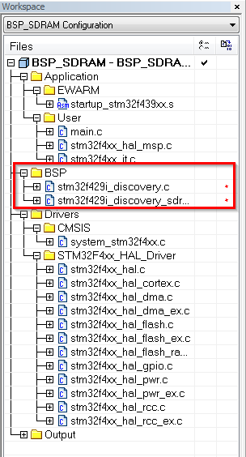
Use BSP for SDRAM initialization
5.1
Now we need to add this files also in project
Create BSP folder in project
Right click on project in Workplace>ADD>Group
Name it BSP
Now right click on BSP>ADD>Files
From Drivers\BSP\STM32F429I-Discovery\ add stm32f429i_discovery.c and stm32f429i_discovery_sdram.c

Slide 44
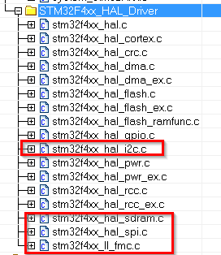
Use BSP for SDRAM initialization
The stm32f429i_discovery.c contains functions for all components on discovery kit (LCD, GYRO,…)
Then we also need add into project HAL library which handle their interface (I2C, SPI, … )
Right click on STM32F4xx_HAL_Drive>ADD from \Drivers\STM32F4xx_HAL_Driver\Src
stm32f4xx_hal_i2c.c
stm32f4xx_hal_spi.c
stm32f4xx_hal_sdram.c
stm32f4xx_II_fmc.c

Slide 45
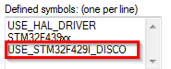
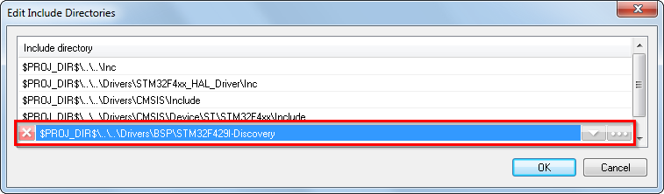
Use BSP for SDRAM initialization
Now add the include paths for this new files
Right click on project>Options>Category C/C++Compiler>Preprocesor
Into Defined symbols add USE_STM32F429I_DISCO
This allow use BSP functions
Into additional includes add $PROJ_DIR$\..\..\Drivers\BSP\STM32F429I-Discovery
Button OK
Button OK close project options

Slide 46
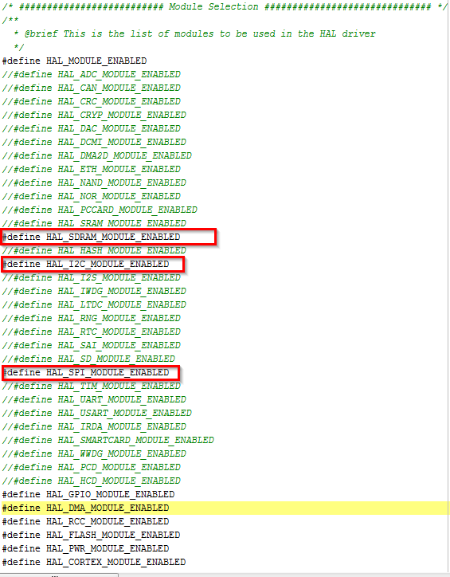
Use BSP for SDRAM initialization
Now last thing is allow to include new HAL files which we added
Open stm32f4xx_hal_conf.h in ..\Inc\
Uncomment files which we added
HAL_SDRAM_MODULE_ENABLED
HAL_I2C_MODULE_ENABLED
HAL_SPI_MODULE_ENABLED

Slide 47
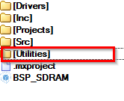
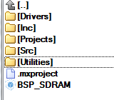
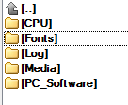
Use BSP for LCD init and writing
The copy part
In our project in Drivers folder create folder Utilities
Now go into CubeMX repository …\STM32Cube_FW_F4_V1.3.0\Utilities\
And copy Fonts into Utilities folder
Copy folders into Utilities

Slide 48
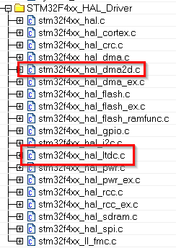
Use BSP for LCD init and writing
We add the driver for LCD from HAL
Right click on STM32F4xx_HAL_Drive>ADD from \Drivers\STM32F4xx_HAL_Driver\Src
stm32f4xx_hal_ltdc.c
Stm32f4xx_hal_dma2d.c

Slide 49
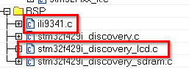
Use BSP for LCD init and writing
We add the driver for BSP LDC
Right click on BSP>ADD from \Drivers\BSP\STM32F429I-Discovery\
stm32f429i_discovery_lcd.c
Right click on BSP>ADD from \Drivers\BSP\Components\ili9341\
ili9341.c

Slide 50
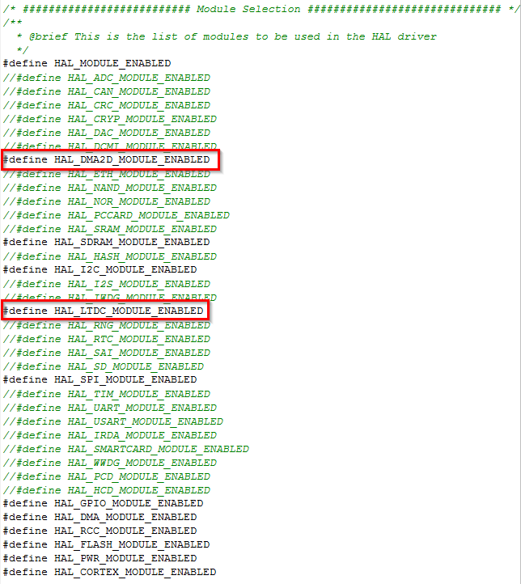
Use BSP for LCD init and writing
Now last thing is allow to include new HAL files which we added
Open stm32f4xx_hal_conf.h in ..\Inc\
Uncomment files which we added
HAL_DMA2D_MODULE_ENABLED
HAL_LTDC_MODULE_ENABLED

Slide 51



Use Middleware for STemWin
The copy part
In our project folder create Middlewares and inside it create ST folder
Now go into CubeMX repository …\STM32Cube_FW_F4_V1.9.0\Middlewares\ST
And copy STemWin folder

Slide 52

Use Middleware for STemWin
Create a folder named Middlewares and follow the image below for further structure
The files needed are:
GUI_X.c
GuiConf.c
LCDConf_stm32f429i_disco_MB1075.c
STemWin524b_CM4_IAR.a
Copy from repository.. STM32Cube_FW_F4_V1.9.0\Middlewares\ST\STemWin\OS
Copy from repository.. STM32Cube_FW_F4_V1.9.0\Projects\STM32F429I-Discovery\Applications\STemWin\STemWin_HelloWorld\Src
Copy from repository.. STM32Cube_FW_F4_V1.9.0\Middlewares\ST\STemWin\Lib

Slide 53

Adding touch sense
We add the driver for the BSP touch sense
Right click on BSP>ADD from \Drivers\BSP\Components\ili9341\
stmpe811.c

Slide 54
Adding touch sense
In order to enable the touch sense interface for the display the following code needs to be added
void HAL_TIM_PeriodElapsedCallback(TIM_HandleTypeDef *htim)
{
BSP_Background();
}
void BSP_Background(void)
{
BSP_LED_Toggle(LED4);
/* Capture input event and updade cursor */
if(GUI_Initialized == 1)
{
BSP_Pointer_Update();
}
}

Slide 55
Adding touch sense
In order to enable the touch sense interface for the display the following code needs to be added
void BSP_Pointer_Update(void)
{
GUI_PID_STATE TS_State;
static TS_StateTypeDef prev_state;
TS_StateTypeDef ts;
uint16_t xDiff, yDiff;
BSP_TS_GetState(&ts);
TS_State.Pressed = ts.TouchDetected;
xDiff = (prev_state.X > ts.X) ? (prev_state.X - ts.X) : (ts.X - prev_state.X);
yDiff = (prev_state.Y > ts.Y) ? (prev_state.Y - ts.Y) : (ts.Y - prev_state.Y);
if((prev_state.TouchDetected != ts.TouchDetected )||(xDiff > 3 )|| (yDiff > 3))
{
prev_state = ts;
TS_State.Layer = 0;
TS_State.x = ts.X;
TS_State.y = ts.Y;
GUI_TOUCH_StoreStateEx(&TS_State);
}
}

Slide 56
Adding Interrupt Service
In stm32f4xx_it.c add the following code
/* Includes ------------------------------------------------------------------*/
#include "stm32f4xx_hal.h"
#include "main.h"
#include "stm32f4xx_it.h"
#include "GUI.h"
/* Private typedef -----------------------------------------------------------*/
/* Private define ------------------------------------------------------------*/
/* Private macro -------------------------------------------------------------*/
/* Private variables ---------------------------------------------------------*/
extern volatile GUI_TIMER_TIME OS_TimeMS;
extern LTDC_HandleTypeDef hltdc;
extern TIM_HandleTypeDef TimHandle;

Slide 57
Adding Interrupt Service
In stm32f4xx_it.c add the following code
void SysTick_Handler(void)
{
/* Update the LocalTime by adding 1 ms each SysTick interrupt */
HAL_IncTick();
OS_TimeMS++;
}
void LTDC_IRQHandler(void)
{
HAL_LTDC_IRQHandler(&hltdc);
}

Slide 58
Adding includes and calls
In main.c add the following code
/* Includes ------------------------------------------------------------------*/
#include "main.h"
#include "WM.h"
extern char pisca;
/* Private typedef -----------------------------------------------------------*/
/* Private define ------------------------------------------------------------*/
/* Private macro -------------------------------------------------------------*/
/* Private variables ---------------------------------------------------------*/
uint8_t GUI_Initialized = 0;
/* Private function prototypes -----------------------------------------------*/
static void BSP_Config(void);
void BSP_Pointer_Update(void);
void BSP_Background(void);

Slide 59
Adding includes and calls
In main.c add the following code
HAL_Init();
/* Initialize LCD and LEDs */
BSP_Config();
/* Configure the system clock to 180 Mhz */
SystemClock_Config();
HAL_TIM_Base_Start_IT(&TimHandle);
/* Init the STemWin GUI Library */
GUI_Init();
GUI_Initialized = 1;
while (1)
{
GUI_Exec();
}

Slide 60

Configure the heap size

Slide 61
STemWin

Slide 62


CONTENTS
Objectives of the STemWin solution
Basic 2D library
PC SW Tools
Window manager
Configuration
Other selected feautres

Slide 63
OBJECTIVES
Provide a high level graphical library which:
Is easy to use
Is flexible to customize
Provides graphical objects from simple 2D elements to complex window driven objects
Uses the ST LTDC and Chrome-ART HW features without their detailed knowledge
Is the industry standard in embedded field
Suits to project of every size → STemWin is free of charge!
As the precompiled object library
Source codes available for the LTDC low level driver
63

Slide 64
CONTENTS
Objectives of the STemWin solution
Basic 2D library
PC SW Tools
Window manager
Configuration
Other selected feautres

Slide 65

Basic 2D library
With STemWin you can easily draw basic vector objects as
Lines, rectangles, arcs, polygons, graphs, bitmaps, JPEGs, PNGs and more
Objects are drawn by a foreground color
GUI_SetColor(GUI_RED);
STemWin supports Alpha blending – objects can overlay each other.
Text and values can be easily written on the screen
65

Slide 66

Basic 2D library - examples
GUI_SetColor(GUI_RED);
GUI_SetDrawMode(GUI_DRAWMODE_NORMAL);
GUI_FillCircle(120, 120, 80);
GUI_SetDrawMode(GUI_DRAWMODE_XOR);
GUI_FillCircle(140, 140, 80);
66
Notes:
XOR – invert points, lines …
void GUI_FillCircle(int x0, int y0, int radius);
(STemWin manual) The horizontal scale is called the X-axis, whereas the vertical scale is called the Y-axis. Coordinates are denoted as a pair consisting of an X- and a Y-value (X, Y). The X-coordinate is always first in routines that require X and Y coordinates. The upper left corner of the display (or a window) has per default the coordinates (0,0)
This position should be natural to everyone as the text in book is always starting like this, screen refresh is also performed this starting from this point.

Slide 67

Basic 2D library - examples
GUI_SetBkColor(GUI_YELLOW);
GUI_Clear();
GUI_SetColor(GUI_BLUE);
GUI_SetPenSize(4);
GUI_DrawLine(20, 20, 50, 190);
GUI_DrawLine(20, 190, 50, 20);
GUI_DrawRoundedRect(70, 30, 170, 190, 15);
{
const GUI_POINT aPoints[8] = {
{ 160, 30},{ 170, 100},
{ 240, 110}, { 170, 120},
{ 160, 190}, { 150, 120},
{ 90, 110}, { 150, 100},
};
GUI_FillPolygon((GUI_POINT *)aPoints, 8, 0, 0);
}
67
Notes:
void GUI_DrawLine(int x0, int y0, int x1, int y1);
void GUI_DrawRoundedRect(int x0, int y0, int x1, int y1, int radius);
void GUI_FillPolygon(const GUI_POINT * pPoint, int NumPoints, int x, int y);

Slide 68

Basic 2D library - examples
GUI_SetBkColor(GUI_YELLOW);
GUI_Clear();
GUI_SetColor(GUI_BLACK);
GUI_DrawPie(100, 100, 50, 0, 60, 0);
GUI_DrawPie(100, 100, 50, 120, 180, 0);
GUI_DrawPie(100, 100, 50, 240, 300, 0);
GUI_DrawArc(120, 240, 40, 0, 0, 180);
GUI_DrawArc(120, 240, 50, 0, 30, 90);
GUI_DrawArc(120, 240, 60, 0, 30, 90);
GUI_DrawArc(120, 240, 70, 0, 30, 90);
68
Notes:
void GUI_DrawPie(int x0, int y0, int r, int a0, int a1, int Type);
x0 X-position of the center of the circle in pixels of the client window.
y0 Y-position of the center of the circle in pixels of the client window.
r Radius of the circle (half the diameter).
a0 Starting angle (degrees).
a1 End angle (degrees).
Type (reserved for future use, should be 0)
void GUI_DrawArc(int xCenter, int yCenter, int rx, int ry, int a0, int a1);
xCenter Horizontal position of the center in pixels of the client window.
yCenter Vertical position of the center in pixels of the client window.
rx X-radius (pixels).
ry Y-radius (pixels). – currently not used
a0 Starting angle (degrees).
a1 Ending angle (degrees).

Slide 69


Basic 2D library - Antialiasing
Antialiasing (AA) smoothens curves and diagonal lines by "blending" the background color with that of the foreground.
Text
Font converter is required for creating AA fonts.
Circles
Arcs
Lines
Polygons
GUI_SetBkColor(GUI_YELLOW);
GUI_Clear();
GUI_SetColor(GUI_BLACK);
GUI_AA_SetFactor(4);
GUI_AA_DrawArc(120, 240, 40, 0, 0, 180);
GUI_AA_DrawArc(120, 240, 50, 0, 30, 90);
GUI_AA_DrawArc(120, 240, 60, 0, 30, 90);
GUI_AA_DrawArc(120, 240, 70, 0, 30, 90);
The higher the number of shades used between background and foreground colors, the better the antialiasing result (and the longer the computation time).
69
Notes:
Factor = 4 –> means 4x4 shades of grey, far from 50 Shades of Grey, but still good enough
(STemWin5 manual) Factor 4 should be sufficient for most applications. Increasing the antialiasing factor further does not improve the result significantly, but increases the calculation time dramatically.

Slide 70

Basic 2D library – text
STemWin enables you to add text of any font into your GUI
Several API functions are available to ease text use
Display text at specific position
Manage text inside a rectangle
GUI_SetBkColor(GUI_YELLOW);
GUI_Clear();
GUI_SetColor(GUI_BLACK);
GUI_SetFont(&GUI_Font8x16);
GUI_DispString("Hello from origin");
GUI_DispStringAt("Hello here, I'm at: 20,30", 20,30);
{
GUI_RECT pRect = {60, 100, 220, 300};
GUI_DrawRect(60, 100, 220, 300);
GUI_DispStringInRectWrap("Hello from rectangle, my name is STM32F4 and I love C programming", &pRect, GUI_TA_VCENTER | GUI_TA_HCENTER, GUI_WRAPMODE_WORD);
}
70
Notes:
void GUI_DispStringInRectWrap(const char GUI_UNI_PTR * s,
GUI_RECT * pRect,
int TextAlign (VCENTER, HCENTER, TOP, BOTTOM, LEFT, RIGHT can be combined with OR operand),
GUI_WRAPMODE WrapMode (word/char));

Slide 71



Human interface
Communication between the application and the user is mostly done by keyboard and/or Pointer Input Devices or touch devices. The following functions are available:
GUI_StoreKeyMsg()
If a keyboard event occurs (pressing or releasing a key) it should be passed to this routine.
GUI_PID_StoreState()
If a PID event occurs (pressed, released or changing the position) it should be passed to this routine.
GUI_TOUCH_StoreState()
In case of human touch on touchscreen, this function should be called
The WM then automatically polls the keyboard and the PID buffer. Keyboard input will be passed to the currently focused window and PID input to the respective window
71

Slide 72

Windows Manager
What is the Window Manager?
Management system for a hierarchic window structure
Each layer has its own desktop window. Each desktop window can have its own hierarchic tree of child windows.
Callback mechanism based system
Communication is based on an event driven callback mechanism. All drawing operations should be done within the WM_PAINT event.
Foundation of widget library
All widgets are based on the functions of the WM.
Basic capabilities:
Automatic clipping
Automatic use of multiple buffers
Automatic use of memory devices
Automatic use of display driver cache
Motion support
72

Slide 73
WM – callback mechanism
The callback mechanism requires a callback routine for each window. These routines have to support the following:
Painting the window
Each window has to draw itself. This should be done when receiving a WM_PAINT message.
Default message handling
Plain windows need to call the function WM_DefaultProc() to avoid undefined behavior of the window.
Further the WM needs to 'stay alive'. This can be done within a simple loop after creating the windows. It has nothing to do but calling GUI_Delay()or GUI_Exec() which does the following:
PID management
Key input management
Timer management
73
Notes:
The window management of the WM is based on a callback mechanism

Slide 74

hButton = BUTTON_Create( 10, 10, 100, 100, GUI_ID_BUTTON0, WM_CF_SHOW);
BUTTON_SetText(hButton, "Click me...");
WM_SetCallback(WM_HBKWIN, myCbBackgroundWin);
WM_SetCallback(hButton, myCbButton);
... ... ...
static void myCbBackgroundWin(WM_MESSAGE *pMsg) {
int NCode, Id;
switch (pMsg->MsgId) {
case WM_NOTIFY_PARENT:
Id = WM_GetId(pMsg->hWinSrc); /* Id of widget */
NCode = pMsg->Data.v; /* Notification code */
if ((Id == GUI_ID_BUTTON0) && (NCode == WM_NOTIFICATION_RELEASED))
buttonClicked = 0;
break;
case WM_PAINT:
GUI_SetBkColor(STBLUE);
GUI_Clear();
break;
default:
WM_DefaultProc(pMsg);
}
}
... ... ...
static void myCbButton(WM_MESSAGE *pMsg) {
switch (pMsg->MsgId) {
case WM_TOUCH:
if (((GUI_PID_STATE*)(pMsg->Data.p))->Pressed == 1)
buttonClicked = 1;
break;
case WM_SIZE:
// add some code
break;
default:
BUTTON_Callback(pMsg);
}
}
Initialization – called only once!
On release WM calls parent callback function with message informing about child touch release
Redraw part
On click WM calls Button callback function
Default callback must be called to achieve proper functionality
74
Notes:
The window management of the WM is based on a callback mechanism
To create object, only the first 4 lines are needed. WM_SetCallback assigns user callback function to the object. If anything happens to the object – this function is called.
WM_HBKWIN is a fixed handle of background window – always present. It’s a parent of any other objects. So if we click the button, the button callback is called but also the parent is notified.
WM_PAINT event must take care of repainting – otherwise nothing will be on the screen, e.g. if the button is moved.

Slide 75
WM – Widget library
Widget = Window + Gadget
Currently the following widgets are supported:
Button, Checkbox, Dropdown, Edit, Framewin, Graph, Header, Iconview, Image, Listbox, Listview, Listwheel, Menu, Multiedit, Progbar, Radio, Scrollbar, Slider, Text, Treeview
Creating a widget can be done with one line of code.
For each widget there exist creation functions: <WIDGET>_CreateEx() // Creation without user data. <WIDGET>_CreateUser() // Creation with user data.

Slide 76

WM – Widget library

Slide 77

Example PLAYER application
Let’s rework our PLAYER example using WM.
Start with single button for prompt the user to select song
#include "BUTTON.h"
static BUTTON_Handle hButton;
GUI_SetBkColor(GUI_BLUE);
GUI_Clear();
GUI_SetColor(GUI_BLACK);
hButton = BUTTON_Create( 240/2 - 80 / 2, 320/2 - 20 / 2, 80, 20, GUI_ID_OK, WM_CF_SHOW);
BUTTON_SetText(hButton, "Load File");
GUI_Exec();
Always include the widget header
Only after call of this function the windows get paint
77

Slide 78
WM – Skinning
Skinning is a method of changing the appearance of one or multiple widgets.
A skin is just a simple callback function which is available for drawing all details of a widget.
These widgets can be skinned:
BUTTON
CHECKBOX
DROPDOWN
FRAMEWIN
HEADER
PROGBAR
RADIO
SCROLLBAR
SLIDER
Before | After

Slide 79
Interfacing to HW, configuration
STemWin is high level GUI package, but it needs a low level driver to access MCU resources
In the package, there are 2 drivers:
STM32F4 LTDC customized driver which benefits from Chrome-ART acceleration for copying/fill routines
FlexColor driver used for interfacing external LCD drivers through FSMC interface. E.g. popular Ilitek ILI9320, ILI9325 or Himax HX8347 devices.
Configuration through LCD_Conf.c, for example:
#define GUI_NUM_LAYERS 2 // defines how many layers are used
#define XSIZE_PHYS 480 // set-up the physical dimensions
#define YSIZE_PHYS 272
// and the color mode for layer 0
#define COLOR_MODE_0 CM_ARGB8888
// physical address of the frame buffer
#define LCD_FRAME_BUFFER ((U32)0xC0000000)

Slide 80



Other STemWin features
And many others:
Motion JPEG video
Support for real time operating systems
Dialogs
GUIBuilder SW
Sprites
Arabic, Thai, Chinese, Japanese fonts
VNC Server
Notes:
Thread safe – use precompiled OS variant

Slide 81
STemWin
Hands On session

Slide 82

Using the GUI Builder

Slide 83

Create a Simple Text

Slide 84

Create a Button

Slide 85

Create CheckBox

Slide 86

Create ProgressBar

Slide 87


Create 2 Windows

Slide 88

Thank you
www.st.com/stm32f4

